Slide 1

DEPARTMENT OF COMPUTER SCIENCE AND ENGINEERING
Project Work Phase I – Review
“Face Mask Detection using Convolutional Neural Network (CNN) Model”
Under the Guidance of

Slide 2

CONTENTS
Introduction.
Proposed System with Objectives.
Existing System (if any similar system exists).
Literature Survey (Minimum 3 papers per Team Member).
System Architecture.
Methodology.
Advantages.
Applications.

Slide 3
INTRODUCITON
In order to protect ourselves from the COVID-19 Pandemic, almost every one of us tend to wear a face mask.
It becomes increasingly necessary to check if the people in the crowd wear face masks in most public gatherings such as Malls, Theatres, Parks.
The development of an solution to detect if the person is wearing a face mask and allow their entry would be of great help to the society.
This model can also be used to develop a full-fledged software to scan every person before they can enter the public gathering.

Slide 4
PROPOSED SYSTEM
▪
This system aims at classifying whether a person is wearing a mask or not by taking input from
Detect COVID-19 face masks in images
Detect face masks in real-time video streams
In the present scenario due to Covid-19, there is no efficient face mask detection applications which are now in high demand for transportation means, densely populated areas, residential districts, large-scale manufacturers and other enterprises to ensure safety.
Objectives:
To detect whether a person is wearing a mask or not, without getting close to them.
To evaluate and measure the accuracy of the developed algorithm in real-time.

Slide 5
EXISTING SYSTEM
The face mask recognition system uses AI technology to detect the person with or without a mask. It can be connected with any surveillance system installed at your premise.
The authorities or admin can check the person through the system to confirm their identity. The system sends an alert message to the authorized person if someone has entered the premise without a face mask.
The accuracy rate of detecting a person with a face mask is 95-97% depending on the digital capabilities. The data has been transferred and stored automatically in the system to enable reports whenever you want.

Slide 6
LITERATURE SURVEY
[1] A hybrid deep transfer learning model with machine learning methods for face mask detection in the era of the COVID-19 pandemic.
[Mohamed Loey, Gunasekaran Manogaran, Mohamed Hamed N. Taha, Nour Eldeen M. Khalifa]
In this paper, a hybrid model using deep and classical machine learning for face mask detection will be presented.
The proposed model consists of two components. The first component is designed for feature extraction using Resnet50. While the second component is designed for the classification process of face masks using decision trees, Support Vector Machine (SVM), and ensemble algorithm.
Three face masked datasets have been selected for investigation. The Three datasets are the Real-World Masked Face Dataset (RMFD), the Simulated Masked Face Dataset (SMFD), and the Labeled Faces in the Wild (LFW). The SVM classifier achieved 99.64%
▪
▪
02-11-2020
testing accuracy in RMFD.
6

Slide 7
LITERATURE SURVEY
[2] Facial Mask Detection using Semantic Segmentation
[Toshanlal Meenpal, Ashutosh Balakrishnan, Amit Verma]
In this paper the objective of creating a Binary face classifier which can detect faces in any orientation irrespective of alignment and train it in an appropriate neural network to get accurate results.
The model requires inputting an RGB image of any arbitrary size to the model. The model’s basic function is feature extraction and class prediction. The output of the model is a feature vector which is optimized using Gradient descent and the loss function used is Binomial Cross Entropy.
The feature extraction and prediction is performed using pre-defined training weights of VGG 16 architecture.
The method can find applications in advanced tasks such as facial part detection. Overall accuracy is 93%
▪
▪
▪
02-11-2020
7

Slide 8
LITERATURE SURVEY
[3] COVID-19 FACEMASK DETECTION WITH DEEP
LEARNING AND
COMPUTER VISION
[ Vinitha.V, Velantina.V]
In this paper the proposed system focuses on how to identify the person on image/video stream wearing face mask with the help of computer vision and deep learning algorithm by using the OpenCV, Tensor flow, Keras and PyTorch library.
The architecture consists of Mobile Net as the backbone it can be used for high and low computation scenarios. In order to extract more robust features, they utilize transfer learning to adopt weights from a similar task face detection, which is trained on a very large dataset.
We used OpenCV, tensor flow, keras , Pytorch and CNN to detect whether people were wearing face masks or not. The models were tested with images and real-time video streams.
The proposed method achieves state-of-the-art results on a public face mask dataset.
▪
▪
▪
02-11-2020
8

Slide 9
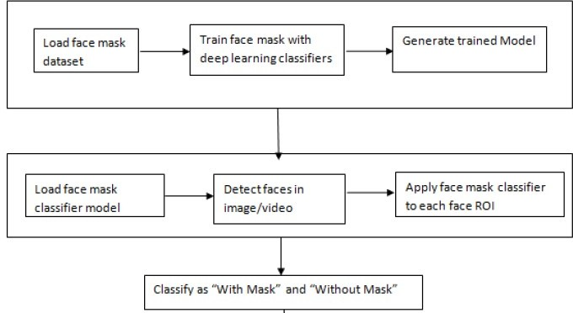
SYSTEM ARCHITECTURE
Figure(a): System Architecture
02-11-2020
9

Slide 10
METHODOLOGY
In the proposed system, four steps are followed, such as:
▪
▪
▪
▪
Data collection and pre-processing Model development and training Model testing
Model implementation

Slide 11
Applications
Under the current Covid-19 lockdown time such system is definitely important to prevent the spread in many use cases. Following are few use cases which will benefit out of this system.
Airports: The proposed System can be of great importance at airports to detect travelers without masks.
Hospitals: The proposed system can be integrated with CCTV cameras and that data may be administered to see if their staff is wearing masks.
Offices and Colleges: The proposed system can be integrated with CCTV cameras and that data may be administered to see if their staff is wearing masks.

Slide 12
THANK YOU!

